Slide 1
Quantum Networks

Slide 2

Quantum Networks

Slide 3
Classical Computing
I am a bit
0
1

Slide 4

Quantum Computing (qbits)
I am like a bit but even better
I am a 0 and a 1 at the same time

Slide 5
Think about it like the Schrödinger Cat
If I confuse you as well, don’t worry it s alright

Slide 6
Qbits Cannot Be Measured or Copied
I am a bit
I am a copy of the bit of the left side
I am a qbit
I used to be a qbit but have been
downgraded to a bit

Slide 7

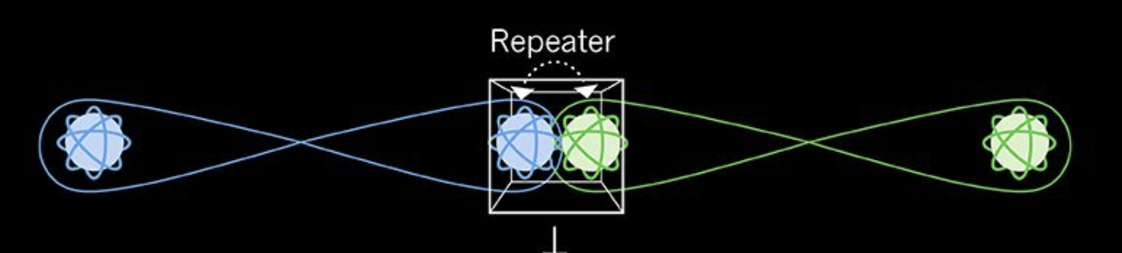
We need Quantum networks to connect quantum computers together and exchange qbits

Slide 8
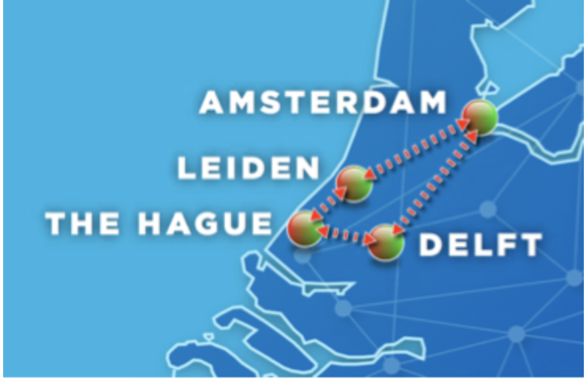
Quantum network which will be finished in the Netherlands by 2020

Slide 9
Topics Addresses in the Hackathon
Bringing concepts of routing and forwarding to the quantum network
The Classical Internet Protocol is not suitable
We worked on adapting classical concepts (MPLS, etc …)
Implemented forwarding in a simulated network
Quantum Ping
How to measure the quality of the quantum connection
Defining the specification of quantum ping
Figuring out the requirements to to establish a quantum ping
Blockchain integration in Quantum networks
Proof of entanglement as a more resource efficient mechanism for consensus

